Slide 1
Introduction to Computer Simulation of Physical Systems (Lecture 7) The Chaotic Motion of Dynamical Systems
PHYS 3061

Slide 2
Simple model:
population growth:
the population in generation n+1 to the population in generation n is given by
P_{n+1} = aP_{n},
P_{n} is the population in generation n and a is a constant.
Assume that
the time interval between generations is unity,
refer to n as the time.

Slide 3
If a < 1,
the population decreases at each generation
eventually the population becomes extinct.
If a > 1,
each generation will be a times larger than the previous one.
geometrical growth and an unbounded population.
In more realistic model, this a may even change.
For example, COVID19, the famous R0 (similar to a here) was about 2.5 at early stage and gradually decayed.
Due to changes in public healthcare policy and changes in human behavior to avoid virus spreading.

Slide 4
Although the unbounded nature of geometrical growth is clear,
it is remarkable
most of us do not integrate our understanding of geometrical growth into our everyday lives.
Can a bank pay 4% interest each year indefinitely?
Can the world’s human population grow at a constant rate forever?
The Fermi paradox

Slide 5
natural to formulate a more realistic model
the population is bounded by the finite carrying capacity of its environment.
A simple model of density-dependent growth is P_{n+1} = P_{n}(a − bP_{n}).

Slide 6
nonlinear due to the presence of the quadratic term in P_{n}.
The linear term: the natural growth of the population;
the quadratic term: a reduction of this natural growth
for example, caused by overcrowding or by the spread of disease.
Game of life.
Similar analogy: Why atoms tend to form molecules and crystals?
Wouldn’t the electron cloud of atoms tend to be repulsive all the way?

Slide 7
convenient to rescale the population
by letting P_{n} = (a/b)x_{n}
x_{n+1} = ax_{n}(1 − x_{n})
The replacement of P_{n} by x_{n} changes the units.
In the standard form,
the parameter r = a/4
And x_{n+1} = f(x_{n}) = 4rx_{n}(1 − x_{n}).
What are the advantage and the problem of this rescaling?

Slide 8
The rescaled form has the desirable feature
its dynamics are determined by a single control parameter r
instead of the two parameters a and b.
Note that if x_{n} > 1, x_{n+1} will be negative!
How to solve this unphysical problem?

Slide 9
To avoid this unphysical feature,
we impose the conditions
that x is restricted to the interval 0 ≤ x ≤ 1 and 0 < r ≤ 1.
Because the function f(x) transforms any point on the one-dimensional interval [0, 1] into another point in the same interval, the function f is called a one-dimensional map.

Slide 10
The form of f(x) is known as the logistic map.
The logistic map is a simple example of a dynamical system,
the map is a deterministic, mathematical prescription for finding the future state of a system given its present state.

Slide 11
The sequence of values x₀, x₁, x₂, . . . is called the trajectory.
To check your understanding, suppose that the initial value of x₀ or seed is x₀ = 0.5 and r = 0.2.
The trajectory is: x1 = 0.2, x2 = 0.128, x3 = 0.089293, …

Slide 12
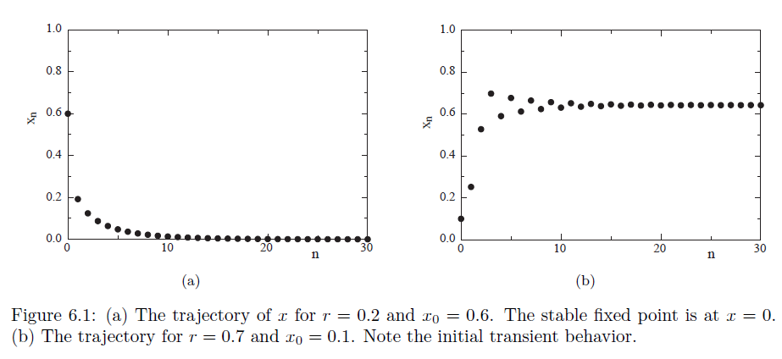
The first thirty iterations are shown for two values of r here.

Slide 13
The class IterateMapApp computes the trajectory of the logistic map.
It extended the AbstractCalculation class,
because many of the results were discovered using a programmable calculator.

Slide 14
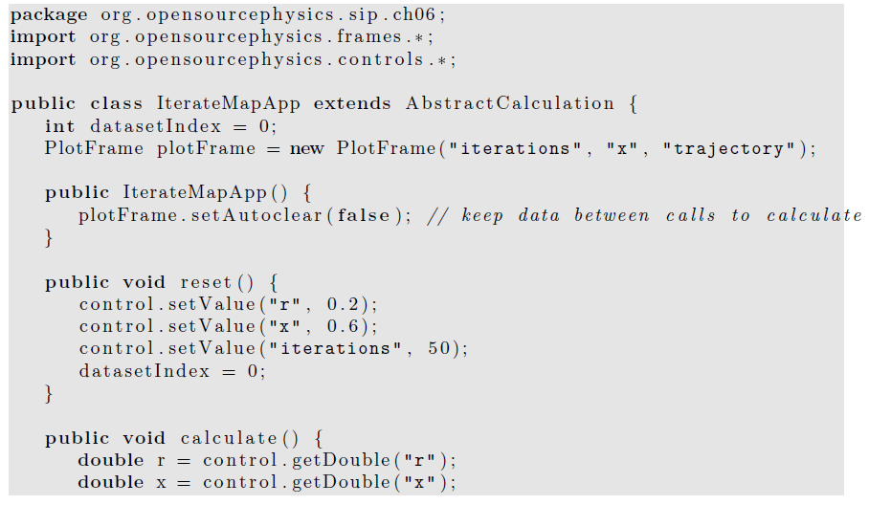

Slide 15
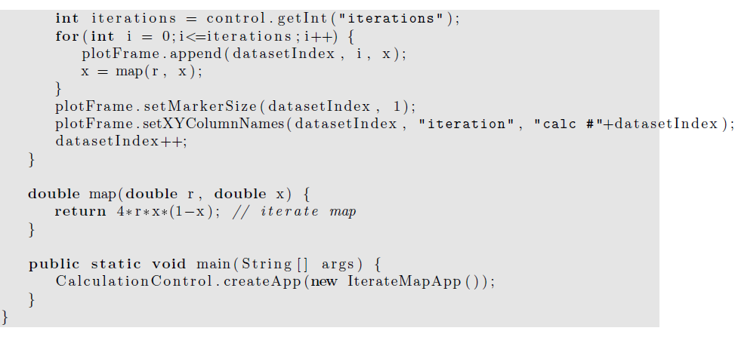

Slide 16
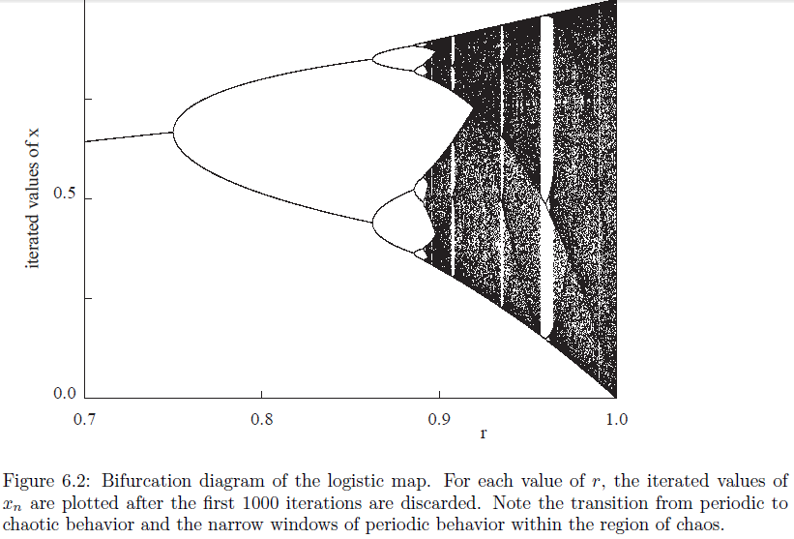
Plot the values of x as a function of r.
The iterated values of x are plotted after the initial transient behavior is discarded.

Slide 17
For each value of r,
the first ntransient values of x are computed
but not plotted.
Then the next nplot values of x are plotted,
with the first half in one color and the second half in another.
This process is repeated
for a new value of r until the desired range of r values is reached.
The magnitude of nplot
at least as large as the longest period that you wish to observe.
BifurcateApp extends AbstractSimulation rather than AbstractCalculation because the calculations can be time consuming, and you might want to stop them before they are finished and reset some of the parameters.

Slide 18
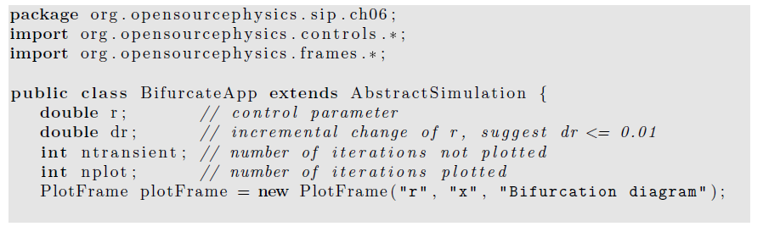
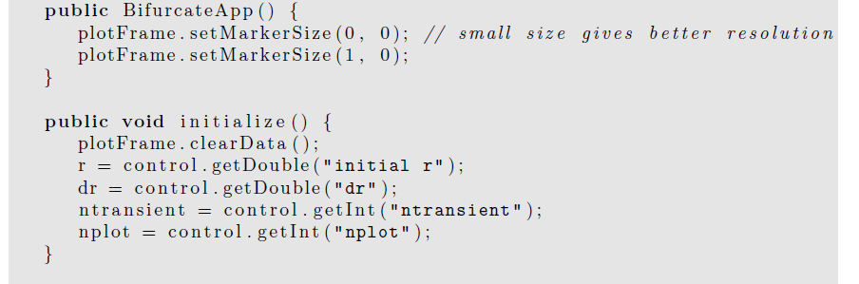

Slide 19
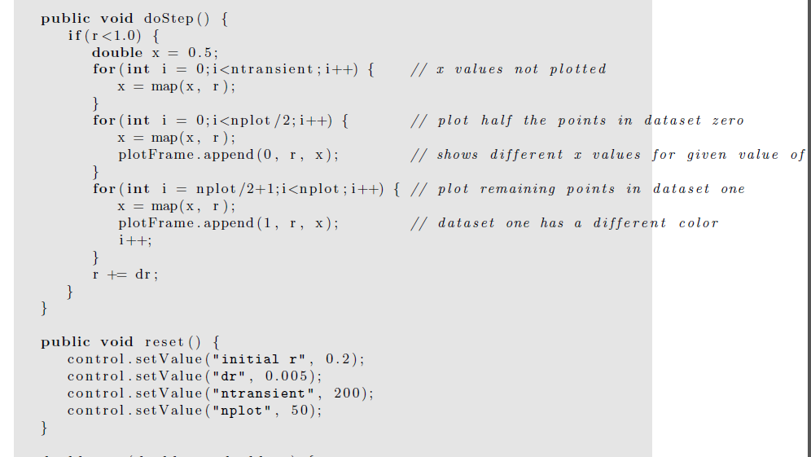
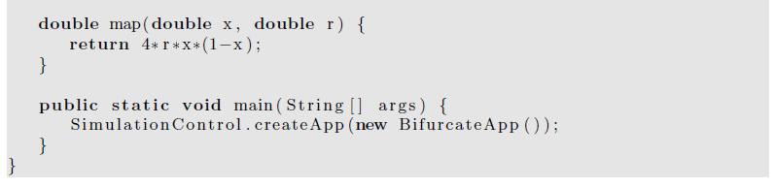

Slide 20
Period Doubling
The results of the numerical experiments shows that
the dynamical properties of a simple nonlinear deterministic system can be quite complicated.
To gain more insight into how the dynamical behavior depends on r,
we introduce a simple graphical method.
We show a graph of f(x) versus x for r = 0.7.
A diagonal line corresponding to y = x intersects the curve y = f(x) at the two fixed points x∗ = 0 and x∗ = 9/14 ≈ 0.642857.

Slide 21
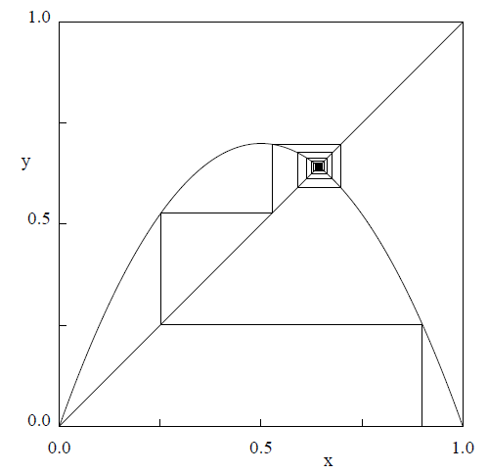
If x₀ is not a fixed point, we can find the trajectory in the following way.
Draw a vertical line from (x = x₀, y = 0) to the intersection with the curve y = f(x) at (x₀, y₀ = f(x₀)).
Next draw a horizontal line from (x₀, y₀) to the intersection with the diagonal line at (y₀, y₀). On this diagonal line y = x, and hence the value of x at this intersection is the first iteration x₁ = y₀.
The second iteration x₂ can be found in the same way.
From the point (x₁, y₀), draw a vertical line to the intersection with the curve y = f(x).
Keep y fixed at y = y₁ = f(x₁), and draw a horizontal line until it intersects the diagonal line;
the value of x at this intersection is x₂.
Further iterations can be found by repeating this process.
Any observations of fixed points on this graph?

Slide 22
If we begin with any x0 (except x0 = 0 and x0 = 1), the iterations will converge to the fixed point x∗ ≈ 0.643.
It would be a good idea to repeat the procedure by hand.
For r = 0.7, the fixed point is stable (an attractor of period 1).
In contrast, no matter how close x₀ is to the fixed point at x = 0, the iterates diverge away from it, and this fixed point is unstable.

Slide 23
How can we explain the qualitative difference between the fixed point at x = 0 and at x∗ = 0.642857 for r = 0.7?
The local slope of the curve y = f(x) determines that the distance moved horizontally each time f is iterated.
A slope steeper than 45◦ leads to a value of x further away from its initial value.
Hence, the criterion for the stability of a fixed point is that the magnitude of the slope at the fixed point must be less than 45◦.
That is, if |df(x)/dx|_{x=x∗} is less than unity, then x∗ is stable;
conversely, if |df(x)/dx|_{x=x∗} is greater than unity, then x∗ is unstable.

Slide 24
An inspection of f(x) shows that
x = 0 is unstable because the slope of f(x) at x = 0 is greater than unity.
In contrast, the magnitude of the slope of f(x) at x = x∗ ≈ 0.643 is less than unity and this fixed point is stable.
x∗= 0 is stable for 0 < r < 1/4, and
x∗= 1 − 1/4r is stable for 1/4 < r < 3/4.

Slide 25
What happens if r is greater than 3/4?
If r is slightly greater than 3/4, the fixed point of f becomes unstable and bifurcates to a cycle of period 2.
Now x returns to the same value after every second iteration, and the fixed points of
f(f(x))are the stable attractors of f(x).
In the following, we write f⁽²⁾(x) = f(f(x)) and f^{(n)}(x) for the nth iterate of f(x).
(Do not confuse f^{(n)}(x) with the nth derivative of f(x).)

Slide 26
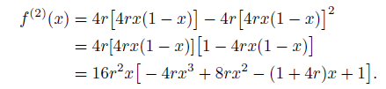
For example, the second iterate f⁽²⁾(x) is given by the fourth-order polynomial:

Slide 27
What happens if we increase r still further?
Eventually the magnitude of the slope of the fixed points of f⁽²⁾(x) exceeds unity and the fixed points of f⁽²⁾(x) become unstable.
Now the cycle of f is period 4, and the fixed points of the fourth iteration
f⁽⁴⁾(x) = f⁽²⁾(f⁽²⁾(x))= f(f(f(f(x))) are stable.
These fixed points also eventually become unstable, and we are led to the phenomena of period doubling

Slide 28
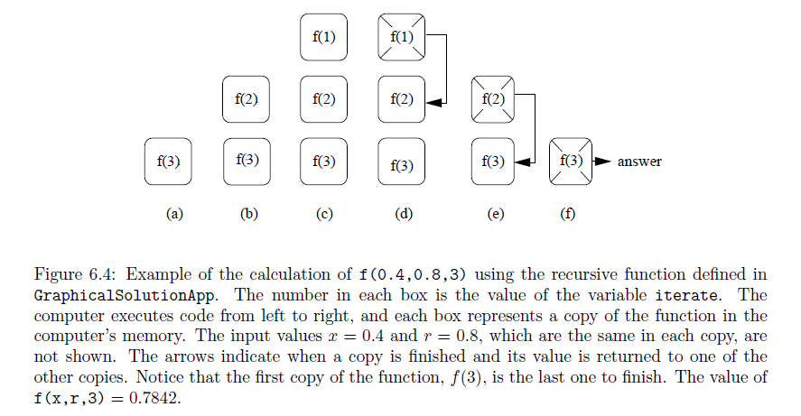
Read the text book for the code of GraphicalSolutionApp, which displays the graphical solution of the logistic map trajectory

Slide 29
Periodic windows in the chaotic regime.
At the bifurcation diagram, you will see that the range of chaotic behavior for r > r∞ is interrupted by intervals of periodic behavior.
Magnify the bifurcation diagram, at the interval 0.957107 ≤ r ≤ 0.960375,
a periodic trajectory of period 3 occurs.
(Period 3 behavior starts at r = (1 +√8)/4.)
An example of intermittency, that is, nearly periodic behavior interrupted by occasional irregular bursts.

Slide 30
Universal Properties and Self-Similarity
In Sections 2 and 3 we found that the trajectory of the logistic map has remarkable properties
as a function of the control parameter r.
A sequence of period doublings accumulating in a chaotic trajectory of infinite period at r = r∞.
For most values of r > r∞, the trajectory is very sensitive to the initial conditions.
We also found “windows” of period 3, 6, 12, . . . embedded in the range of chaotic behavior.
How typical is this type of behavior?
further numerical evidence will show that the general behavior of the logistic map is independent of the details of the form of f(x).

Slide 31
Noticed that the range of r between successive bifurcations becomes smaller as the period increases.
For example, b₂ − b₁ = 0.112398, b₃ − b₂ = 0.023624, and b₄ − b₃ = 0.00508.
A good guess is that the decrease in b_{k} − b_{k−1} is geometric, that is, the ratio (b_{k} − b_{k−1})/(b_{k+1} − b_{k}) is a constant.
You can check that this ratio is not exactly constant, but converges to a constant with increasing k.

Slide 32
This behavior suggests that the sequence of values of b_{k} has a limit and follows a geometrical progression:
b_{k} ≈ r∞ − C δ^{−k},
where δ is known as the Feigenbaum number and C is a constant.
δ is given by the ratio δ = lim (b_{k} − b_{k−1})/(b_{k+1} − b_{k}), when k→∞ .

Slide 33

Mitchell Jay Feigenbaum (born December 19, 1944) is a mathematical physicist whose pioneering studies in chaos theory led to the discovery of the Feigenbaum constants.
In 1975, Dr. Feigenbaum, using the small HP-65 calculator he had been issued, discovered that the ratio of the difference between the values at which such successive period-doubling bifurcations occur tends to a constant of around 4.6692...

Slide 34
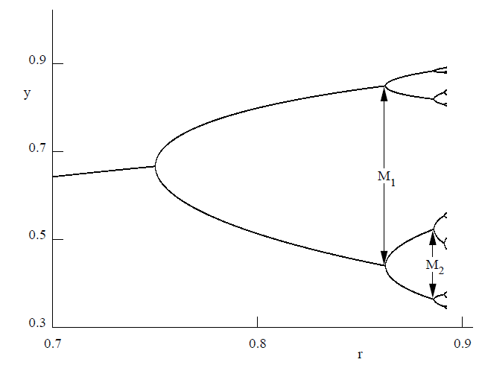
We can associate another number with the series of “pitchfork” bifurcations.
Each pitchfork bifurcation gives birth to “twins” with the new generation more densely packed than the previous generation.
One measure of this density is the maximum distance Mk between the values of x describing the bifurcation

Slide 35
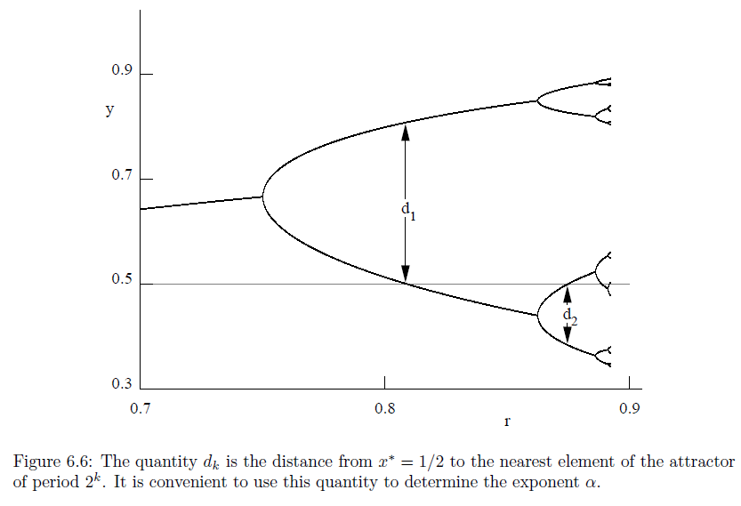
The disadvantage of using Mk is that the transient behavior of the trajectory is very long at the boundary between two different periodic behaviors.
A more convenient measure of the distance is the quantity dk =xk∗ − 1/2,
where xk* is the value of the fixed point nearest to the fixed point x∗ = 1/2.
The first two values of dk are shown in Figure here with d1 ≈ 0.3090 and d2 ≈ −0.1164.
The next value is d3 ≈ 0.0460.
Note that the fixed point nearest to x = 1/2 alternates from one side of x = 1/2 to the other.

Slide 36
We define the quantity α by the ratio α = limk→∞−( d_{k}/d_{k+1}).
The ratios α = (0.3090/0.1164) = 2.65 for k = 1
and α = (0.1164/0.0460) = 2.53 for k = 2 are consistent with the asymptotic value α = 2.5029078750958928485 . . .

Slide 37
qualitative arguments:
that suggest that the general behavior of the logistic map in the period doubling regime is independent of the detailed form of f(x).
doubling is characterized by self-similarities,
for example, the period doublings look similar except for a change of scale.
We can demonstrate these similarities by comparing f(x) for r = s₁ = 0.5 for the superstable trajectory with period 1 to the function f⁽²⁾ (x) for r = s₁ ≈ 0.809017 for the superstable trajectory of period 2

Slide 38
The function f(x, r = s1) has unstable fixed points at x = 0 and x = 1 and a stable fixed point at x = 1/2.
Similarly the function f⁽²⁾(x, r = s2) has a stable fixed point at x = 1/2 and an unstable fixed point at x ≈ 0.69098.
Note the similar shape, but different scale of the curves in the square boxes.

Slide 39
This similarity is an example of scaling.
That is, if we scale f⁽²⁾ and change (renormalize) the value of r, we can compare f⁽²⁾ to f.
This graphical comparison is only suggestive.
A precise approach shows that if we continue the comparison of the higher-order iterates, for example, f⁽⁴⁾(x) to f⁽²⁾(x), etc., the superposition of functions converges to a universal function that is independent of the form of the original function f(x).

Slide 40
Why is the universality of period doubling and the numbers δ and α more than a curiosity?
The reason is that because this behavior is independent of the details, there might exist realistic systems whose underlying dynamics yield the same behavior as the logistic map.
Of course, most physical systems are described by differential rather than difference equations.
Can these systems exhibit period doubling behavior?
Several workers (cf. Testa et al.) have constructed nonlinear RLC circuits driven by an oscillatory source voltage.
The output voltage shows bifurcations, and the measured values of the exponents δ and α are consistent with the predictions of the logistic map.

Slide 41
the nature of turbulence in fluid systems.
Consider a stream of water flowing past several obstacles.
At low flow speeds, the water flows past obstacles in a regular and time-independent fashion, called laminar flow.
As the flow speed is increased (as measured by a dimensionless parameter called the Reynolds number), some swirls develop, but the motion is still time-independent.
As the flow speed is increased still further, the swirls break away and start moving downstream.
The flow pattern as viewed from the bank becomes time-dependent.
For still larger flow speeds, the flow pattern becomes very complex and looks random. We say that the flow pattern has made a transition from laminar flow to turbulent flow.

Slide 42
This qualitative description of the transition to chaos in fluid systems is superficially similar to the description of the logistic map.
Can fluid systems be analyzed in terms of the simple models of the type we have discussed here?
In a few instances such as turbulent convection in a heated saucepan, period doubling and other types of transitions to turbulence have been observed.
The type of theory and analysis we have discussed has suggested new concepts and approaches, and the study of turbulent flow is a subject of much current interest.

Slide 43
Measuring Chaos
How do we know if a system is chaotic?
The most important characteristic of chaos is sensitivity to initial conditions.
We found that the trajectories starting from x0 = 0.5 and x0 = 0.5001 for r = 0.91 become very different after a small number of iterations.

Slide 44
Computers only store floating numbers to a certain number of digits,
the implication of this result: our numerical predictions of the trajectories of chaotic systems are restricted to small time intervals.
Sensitivity to initial conditions implies that even though the logistic map is deterministic, our ability to make numerical predictions of its trajectory is limited.

Slide 45
How can we quantify this lack of predictably?
In general, if we start two identical dynamical systems from slightly different initial conditions, we expect that the difference between the trajectories will increase as a function of n.

Slide 46
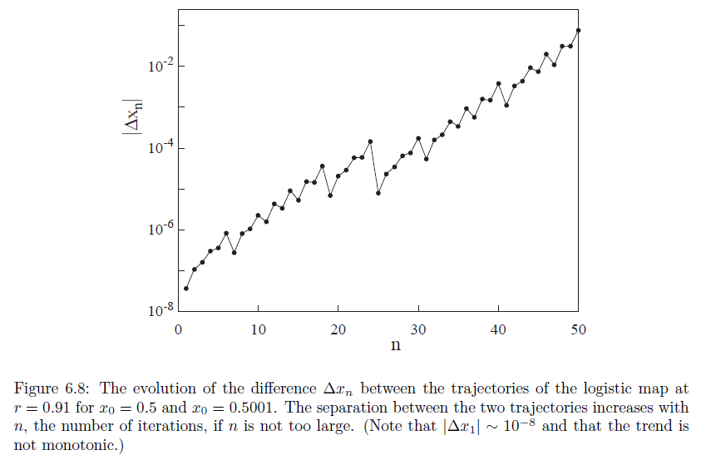
In Figure here we show a plot of the difference |Δx_{n}| versus n.
We see that roughly speaking, ln |Δx_{n}| is a linearly increasing function of n.
This result indicates that the separation between the trajectories grows exponentially if the system is chaotic.

Slide 47
This divergence of the trajectories can be described by the Lyapunov exponent λ, which is defined by the relation:
|Δx_{n}| = |Δx₀| e^{λn}, where Δx_{n} is the difference between the trajectories at time n.
If the Lyapunov exponent λ is positive, then nearby trajectories diverge exponentially.
Chaotic behavior is characterized by the exponential divergence of nearby trajectories.

Slide 48
A naive way of measuring the Lyapunov exponent λ is to run the same dynamical system twice with slightly different initial conditions and measure the difference of the trajectories as a function of n.
Because the rate of separation of the trajectories might depend on the choice of x₀, a better method would be to compute the rate of separation for many values of x₀.
This method would be tedious, because we would have to fit the separation for each value of x₀ and then determine an average value of λ.

Slide 49
A more important limitation of the naive method is that because the trajectory is restricted to the unit interval,
the separation |Δx_{n}| ceases to increase when n becomes sufficiently large.
Fortunately, there is a better way of determining λ.

Slide 50
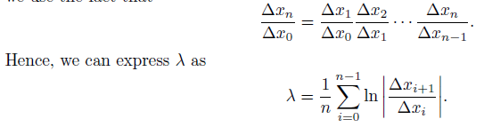
We take the natural logarithm of both sides of the definition and write λ as
λ =1/n ln |Δx_{n}/Δx₀|.
Because we want to use the data from the entire trajectory after the transient behavior has ended, we use the fact that

Slide 51
The form above implies that we can interpret x_{i} for any i as the initial condition.
The problem of computing λ has been reduced to finding the ratio Δx_{i+1}/Δx_{i}.
Because we want to make the initial difference between the two trajectories as small as possible, we are interested in the limit Δx_{i} → 0.

Slide 52
The idea of the more sophisticated procedure is to compute dx_{i+1}/dx_{i} from the equation of motion at the same time that the equation of motion is being iterated.
We use the logistic map as an example.
We have dx_{i+1}/dx_{i}= f′(xi) = 4r(1 − 2x_{i}).

Slide 53
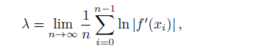
We can consider xi for any i as the initial condition and the ratio dx_{i+1}/dx_{i} as a measure of the rate of change of xi.
Hence, we can iterate the logistic map as before and use the values of x_{i} and the relation to compute f′(xi) = dx_{i+1}/dx_{i} at each iteration.
The Lyapunov exponent is given by

Slide 54
we begin the sum in the above equation after the transient behavior is finished.
We have included explicitly the limit n → ∞ to remind ourselves to choose n sufficiently large.
Note that this procedure weights the points on the attractor correctly, that is, if a particular region of the attractor is not visited often by the trajectory, it does not contribute much to the sum.

Slide 55
We have found that nearby trajectories diverge if λ > 0.
For λ < 0, the two trajectories converge and the system is not chaotic.
What happens for λ = 0? In this case we will see that the trajectories diverge algebraically, that is, as a power of n.
In some cases a dynamical system is at the “edge of chaos” where the Lyapunov exponent vanishes.
Such systems are said to exhibit weak chaos to distinguish their behavior from the strongly chaotic behavior (λ > 0) that we have been discussing.

Slide 56
If we define z ≡ |Δx_{n}|/|Δx₀|, then z will satisfy the differential equation dz/dn = λ_{q}z^{q}.
For weak chaos we do not find an exponential divergence,
but instead a divergence that is algebraic and is given by
dz/dn= λ_{q}z^{q},
where q is a parameter that needs to be determined.
The solution is z = [1 + (1 − q)λ_{q}n]^{1/(1-q)},
In the limit q → 1, we recover the usual exponential dependence.

Slide 57
We can determine the type of chaos using the crude approach of choosing a large number of initial values of x₀ and x₀ + Δx₀ and plotting the average of ln z versus n.
If we do not obtain a straight line, then the system does not exhibit strong chaos.
How can we check for the behavior shown in the above equation? The easiest way is to plot the quantity (Z^{1-q} -1 )/ (1-q) versus n.

Slide 58
A system of fixed energy (and number of particles and volume) has an equal probability of being in any microstate specified by the positions and velocities of the particles.
One way of measuring the ability of a system to be in any state is to measure its entropy defined by S = −Σp_{i} ln p_{i},
where the sum is over all states and p_{i} is the probability or relative frequency of being in the ith state.
For example, if the system is always in only one state, then S = 0, the smallest possible entropy.
If the system explores all states equally, then S = ln Ω, where Ω is the number of possible states.

Slide 59
to compute S for the logistic map, we can divide the interval [0, 1] into bins or
subintervals of width Δx = 0.01 and determine the relative number of times the trajectory falls into each bin.
At each value of r in the range 0.7 ≤ r ≤ 1, the map should be iterated for a fixed number of steps, for example, n = 1000. Choose Δx = 0.01.

Slide 60
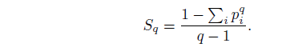
We also can measure the (generalized) entropy as a function of time.
S(n) for strong chaos increases linearly with n until all the possible states are visited.
However, for weak chaos this behavior is not found.
In the latter case we can generalize the entropy to a q-dependent function defined by

